Slide 1
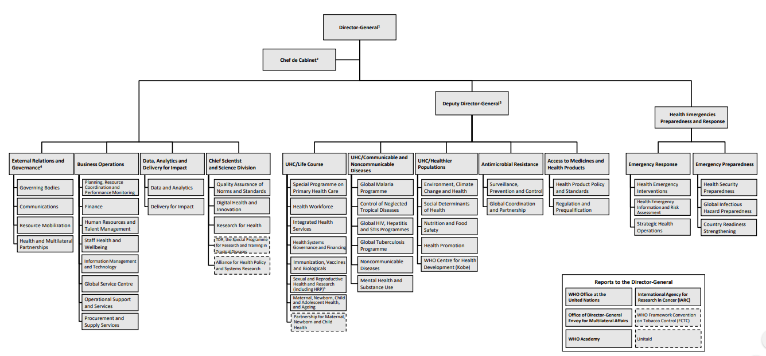
WHO Headquarters

Slide 2


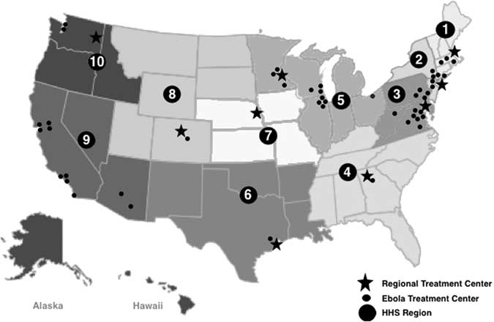
US Dept. Of Health & Human Services (HHS)
Originally called Health, Education & Welfare (1953).
Health Dept. was renamed to HHS (1980).
Public Health Service (PHS) is its main division (corps).
HQ: Washington DC, Employees: 80k, Budget: $1.3T.
3 tiers: Fededral, State, Local Health departments.
10 Regional offices what work with State, Local depts.
National Institutes of Health (NIH, 1887).
Food & Drug Administration (FDA, 1906).
Centers for Disease Control & Prevention (CDC, 1946).
Indian Health Service (HIS, 1955).
Centers for Medicare & Medicaid Services (CMS, 1965).
Health Resources & Services Administration (HRSA, 1982).
Agency for Toxic Substances & Diseases Registry (ATSDR, 1983).
Agency for Healthcare Research & Quality (AHRQ, 1989).
Administration of Children & Families (ACF, 1991).
Substance Abuse & Mental Health Services Administration (SAMHSA, 1992).
Administration for Community Living (ACL, 2012).

Slide 3

National Institutes of Health (NIH)
NIH is responsible for biomedical & health research.
NIH has 21 institutes & 6 centers (across all institutes).
HQ: Bethesda, Employees: 20k, Budget: $39B.
Research published in 12mon to PubMed Central (PMC).
National Cancer Instiute (NCI, 1937).
NI of Allergy & Infectious Diseases (NIAID, 1948).
NI of Dental & Craniofacial Research (NIDCR, 1948).
National Heart, Lung & Blood Institute (NHLBI, 1948).
NI of Mental Health (NIMH, 1949).
NI of Diabetes & Digestive & Kidney Diseases (NIDDK, 1950).
NI of Neurological Disorders & Stroke (NINDS, 1950).
National Library of Medicine (NLM, 1956).
NI of Child Health & Human Development (NICHD, 1962).
NI of General Medical Sciences (NIGMS, 1962).
National Eye Institute (NEI, 1968).
NI of Environmental Health Sciences (NIEHS, 1969).
NI on Alcohol Abuse & Alcoholism (NIAAA, 1970).
NI on Drug Abuse (NIDA, 1974).
NI on Aging (NIA, 1974).
NI of Arthritis & Musculoskeletal & Skin Diseases (NIAMS, 1986).
NI of Nursing Research (NINR, 1986).
NI of Deafness & other Communication Disorders (NIDCD, 1988).
National Human Genome Research Institute (NHGRI, 1989).
NI on Minority health & Health Disparities (NIMHD, 1993).
NI of Biomedical Imaging & Bioengineering (NIBIB, 2000).
NLM's repository

Slide 4

NI of Allergy & Infectious Diseases (NIAID)
NIAID is responsible for basic & applied research to better understand, treat & prevent infectious, immunologic & allergic diseases.
Worked on development of vaccines for Influenza, Hepatitis A, Rotavirus, Pertussis, Pneumonia, RSV.
Worked on development of diagnostic tests for Malaria, Tuberculosis, Norovirus.
Worked on mother to child transmission (MTCT) of HIV.
It has 4 extramural divisions (non-members):
Div. of Acquired Immunodeficiency Syndrome (DAIDS).
Div. of Allergy, Immunology & Transplantation (DAIT).
Div. of Microbiology & Infectious Diseases (DMID).
Div. of Extramural Activities (DEA).
And 3 intramural divisions (done within):
Div. of Clinical Research (DCR).
Div. of Intramural Research (DIR).
Vaccine Research Center (VRC).
VRC has 4 laboratories and 2 programs:
Immunology Laboratory
Viral Pathogenesis Laboratory
Virology Laboratory
Vaccine Production Program Laboratory.
Clinical Trials Program
Translational Research Program

Slide 5
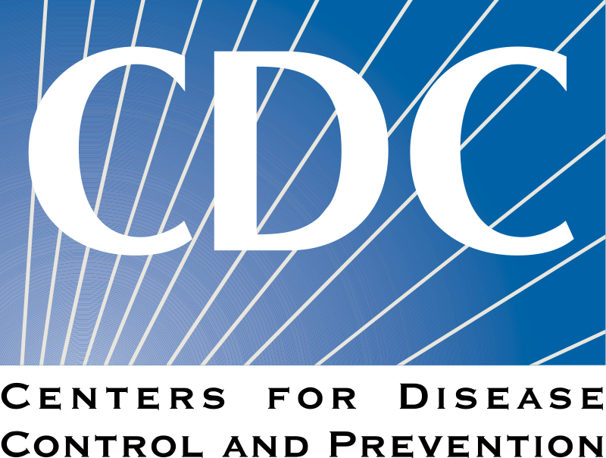
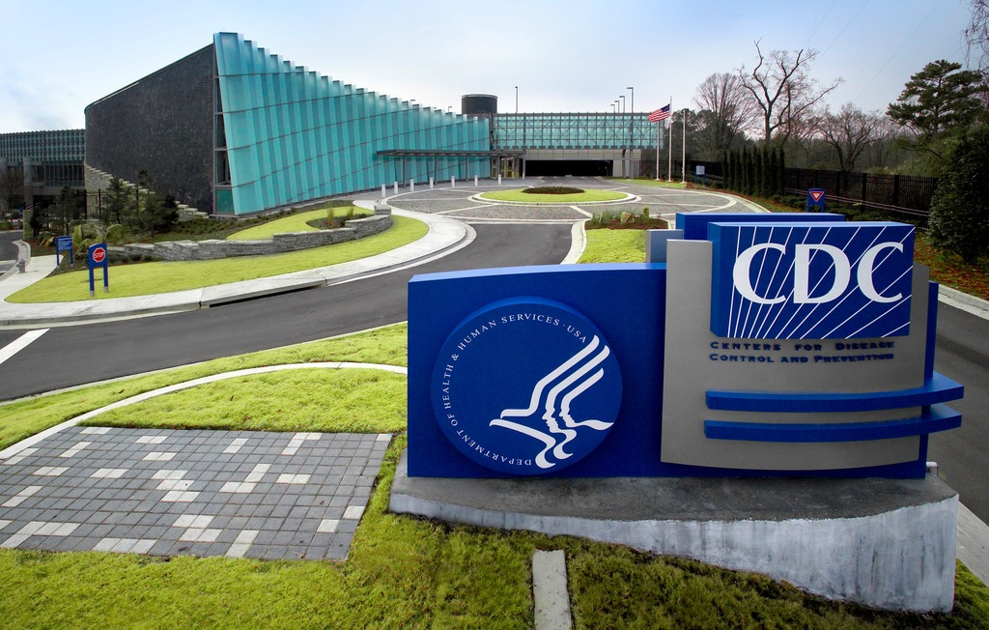
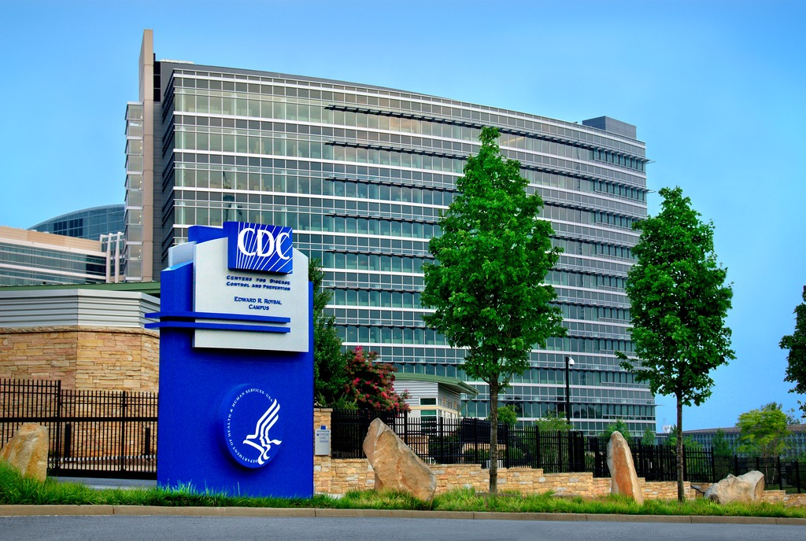
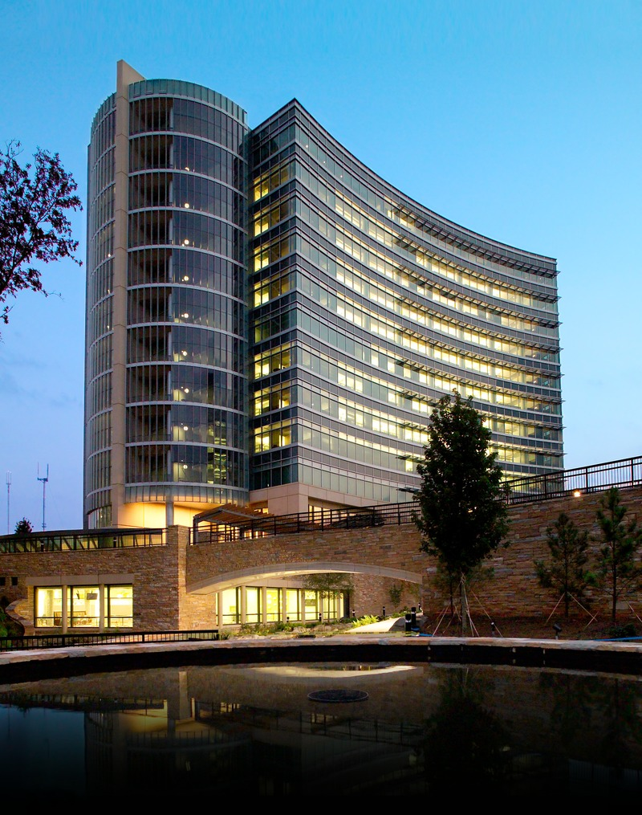
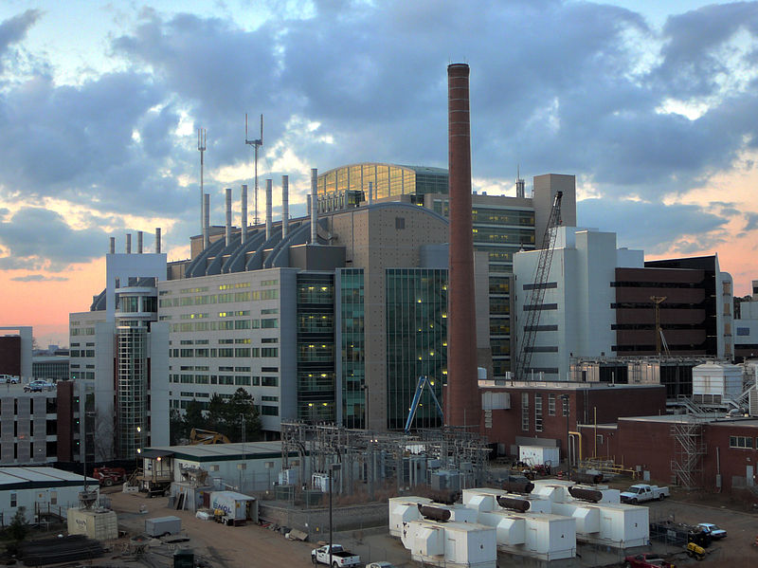
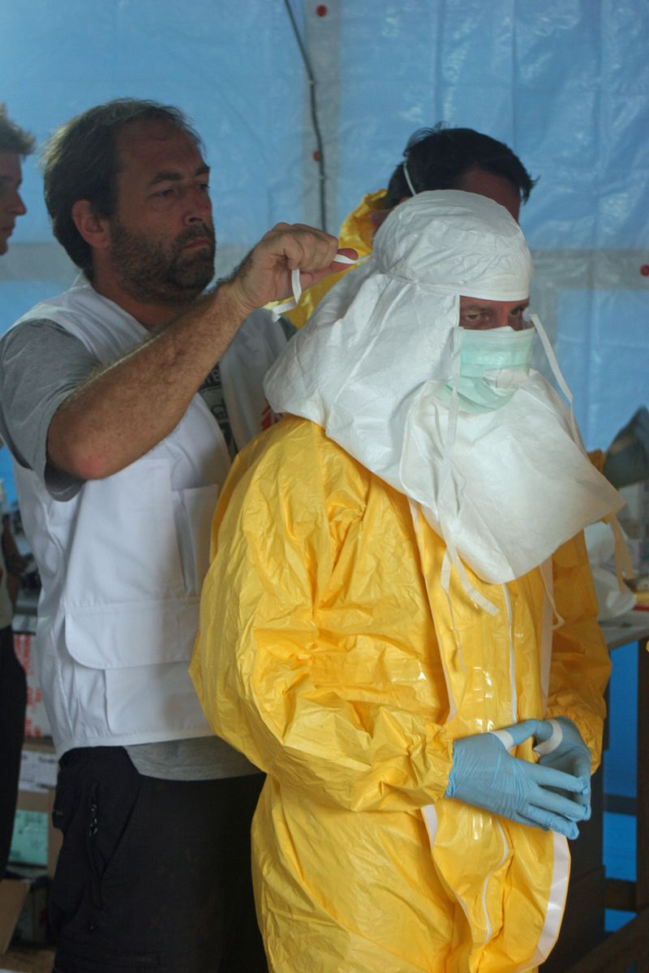
Centers for Disease Control & Prevention (CDC)
CDC is responsible for control & prevention of disease, injury & disability in US and internationally.
Focuses on infectious disease, influenza, food borne pathogens, antibiotic resistance, global, travelers', environmental health, vaccine safety, occupational safety & health, health promotion, injury prevention & education.
Also conducts research on NCDs, e.g. obesity, diabetes.
Founding member of International Association of National Public Health Institutes (IANPHI, 2006, 80 ⚐).
HQ: Atlanta, Employees: 11k, Budget: $12B.
NC for Health Statistics (NCHS, 1960).
NI for Occupational Safety & Health (NIOSH, 1970).
NC for Injury Prevention & Control (1992).
NC for Immunization & Respiratory Diseases (NCIRD, 1993).
NC for Emerging & Zoonotic Infectious Diseases (NCEZID).
NC on Birth Defects & Developmental Disabilities.
NC for Chronic Disease Prevention & Health Promotion.
NC for HIV/AIDS, Viral Hepatitis, STD & TB Prevention (NCHHSTP).
NC for Environmental Health & Agency for Toxic Substances & Disease Registry.
Occupational Safety and Health Administration (OSHA)

Slide 6
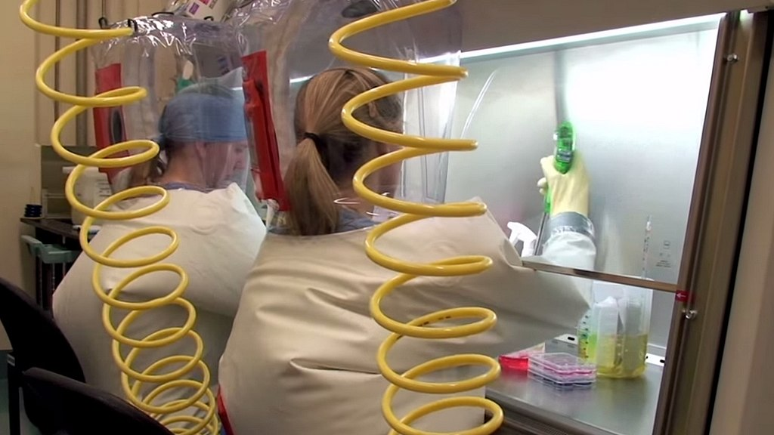
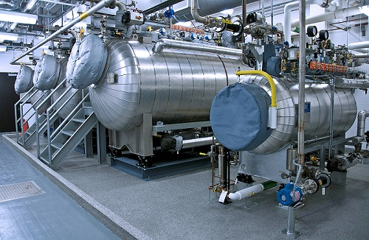
Bio Safety Level (BSL)
Enclosed laboratory facilities for working with dangerous biological agents. Lowest level 1 to highest level 4.
BSL1: used for non-pathogenic microorganisms. Generally used as teaching spaces for high schools & colleges.
BSL2: used for mild disease causing microbes or difficult to spread; Hepatitis A, B, C, HIV, E. Coli, Salmonella.
BSL3: used for potentially lethal or inhalable microbes; biosafety cabinet, protective clothing; SARS-CoV-1/2, MERS-CoV, Chikungunya, Yellow fever, West Nile, Encephalitis.
BSL4: used for fatal or easily transmitted pathogens; class 2/3 biosafety cabinet; autoclave; +ve pressure suit, airlocks, waste decontamination; Ebola, Lassa, Hendra, Nipah, Marburg, Hemorrhagic fever.
Also used for extraterrestrial samples.
3 BSL4 facilities in India.
High Security Animal Disease Laboratory (HSADL, 1998, Bhopal).
Centre for Cellular & Molecular Biology (CCMB, 2009, Hyderabad).
National Institute of Virology (NIV, 2018, Pune).
13 BSL4 facilities in US.
US Army Medical RI of Infectious Diseases (USAMRIID, 1969).
National Emerging Infectious Diseases Laboratory (NEIDL, 2017).
Rocky Mountain Laboratories IRF (RML-NIH, 2008).

Slide 7
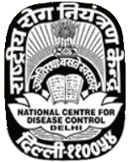
National Centre for Disease Control (NCDC)
NCDC is responsible for research in epidemiology, control of communicable diseases & to reorganize activities of Malaria Institute of India (MII) (1909).
It works under the Ministry of Health & Family Welfare.
NCDC (2009) was originally called Central Malaria Bureau (1909), NI of Communicable Disease (1963).
It investigated outbreaks of Punjab Pneumonic plague (2002), SARS (2004), Delhi Meningitis (2005), Avian Influenza (2006) & COVID-19.
NCDC has 8 branches with headquarters in New Delhi.
It set up Global Disease Detection (GDD) regional centre in New Delhi in collaboration with CDC, establishing the Indian Epidemiological Intelligence System (EIS) program.
NCDC has 14 technical centres / divisions.
Integrated Disease Surveillance Programme (IDSP, 2004).
Centre for AIDS & Related Diseases (CARD).
Epidemiology Division.
Division of Malariology & Coordination (M&C).
Helminthology Division.
Biochemistry & Toxicology.
Biotechnology Division.
Microbiology Division.
Medical Entomology & Vector Management Division (CME&VM).
Zoonosis Division.
Division of Parasitic Disease (DPD).
Centre for Environment & Occupational Health (CE&OH).
Centre for Non-Communicable Diseases (CNCD).
Statistical Monitoring & Evaluation Centre (SM&EC).

Slide 8

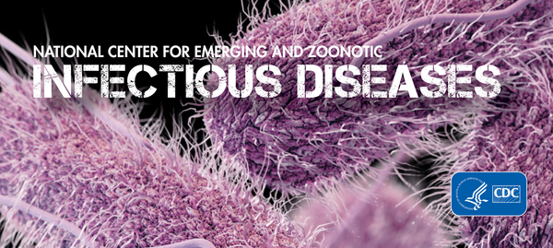
NC for Emerging & Zoonotic Infectious Diseases (NCEZID)
NCEZID is responsible for protecting people from domestic & global health threats.
Foodborne & waterborne illnesses
Infections that spread in hospitals
Infections that are resistant to antibiotics
Deadly diseases like Ebola & Anthrax
Illnesses that affect immigrants, migrants, refugees & travelers.
Diseases caused by contact with animals
Diseases spread by mosquitos, ticks & fleas.
Emerging: completely new (Bourbon, MERS), new area (Chikungunya), reappearing (Dengue), antibiotic resistant (MRSA, C. difficile, drug resistant TB).
Zoonotic: Lyme disease (ticks), Salmonella (poultry), Rabies.
It has 7 divisions working in US & worldwide.
D of Foodborne, Waterborne & Environmental Diseases.
D of Global Migration & Quarantine.
D of Healthcare Quality Promotion.
D of High-Consequence Pathogens & Pathology.
D of Preparedness & Emerging Infections.
D of Scientific Resources.
D of Vector-Borne Diseases.

Slide 9

Ministry of Health & Family Welfare (MoHFW)
Charged with health policy & family planning (1976).
It regularly publishes Indian Pharmacopoeia through IPC.
MoHFW assisted by World Bank launched Integrated Disease Surveillance Programme (IDSP) to detect & respond to outbreaks quickly.
DoH has launched 14 National Health Programmes.
DoFW has 18 Population Research Centres (PRCs).
Department of Health Research (DHR, 2007).
4 Bodies under Department of Family Welfare.
Indian Council of Medical Research (ICMR, 1911, New Delhi).
Central Drug Research Institute (CDRI, 1951, Lucknow).
II of Population Sciences (IIPS, 1956, Mumbai).
NI of Health & Family Welfare (NIHFW, Delhi).
12 bodies under Department of Health.
AII of Hygiene & Public Health (AIIH&PH, 1932, Kolkata).
Indian Nursing Council (1947).
Dental Council of India (DCI, 1948).
Pharmacy Council of India (PCI, 1948).
National Medical Council (NMC, 2020).
National Centre for Disease Control (NCDC, 1963).
AII of Speech & Hearing (AIISH, 1966, Mysore).
AII of Physical Medicine & Rehabilitation (AIIPMR, Mumbai).
Hospital Services Consultancy Corporation (HSCC, 1983, Noida).
Central Drugs Standard Control Organization (CDSCO).
National AIDS Control Organisation (NACO, 1992).
Food & Safety Standards Authority of India (FSSAI, 2011, Delhi).

Slide 10

Indian Council of Medical Research (ICMR)
ICMR is the apex body in India for formulation, coordination & promotion of biomedical research.
ICMR is one of the oldest & largest in the world.
It researches on control & management of communicable diseases, fertility control, maternal & child health, control of nutritional disorders, alternative strategies for health care, containment of environmental & occupational health problems, research on major non-communicable diseases, mental health research & drug research.
It established Clinical Trials Registry India (CTRI, 2007).
ICMR promotes extramural & intramural research.
It has 105 Viral Research & Diagnostic Laboratories (VRDL).
ICMR has 26 research institutes for specific research.
It publishes Indian Journal of Medical Research monthly.
NI of Nutrition (NIN, 1918, Hyderabad).
NI of Virology (NIV, 1952, Pune).
NI for Research in Tuberculosis (NIRT, 1956, Chennai).
Rajendra Memorial RI of Medical Sciences (RMRIMS, 1963, Patna).
NI of Research in Reproductive Health (NIRRH, 1970, Mumbai).
NI of Malaria Research (NIMR, 1977, Delhi).
N AIDS Research Institute (NARI, 1992, Pune).
NI of Epidemiology (NIE, 1999, Chennai).
N Animal Resource Facility for Biomedical Research (2015, Hyd.).
Microbial Containment Complex (MCC, Pune).
NI of Medical Statistics (NIMS, Delhi).
NC for Disease Informatics & Research (NCDIR, Bengaluru).
NI of Occupational Health (Ahmedabad).
ICMR Virus Unit (Kolkata).
...

Slide 11
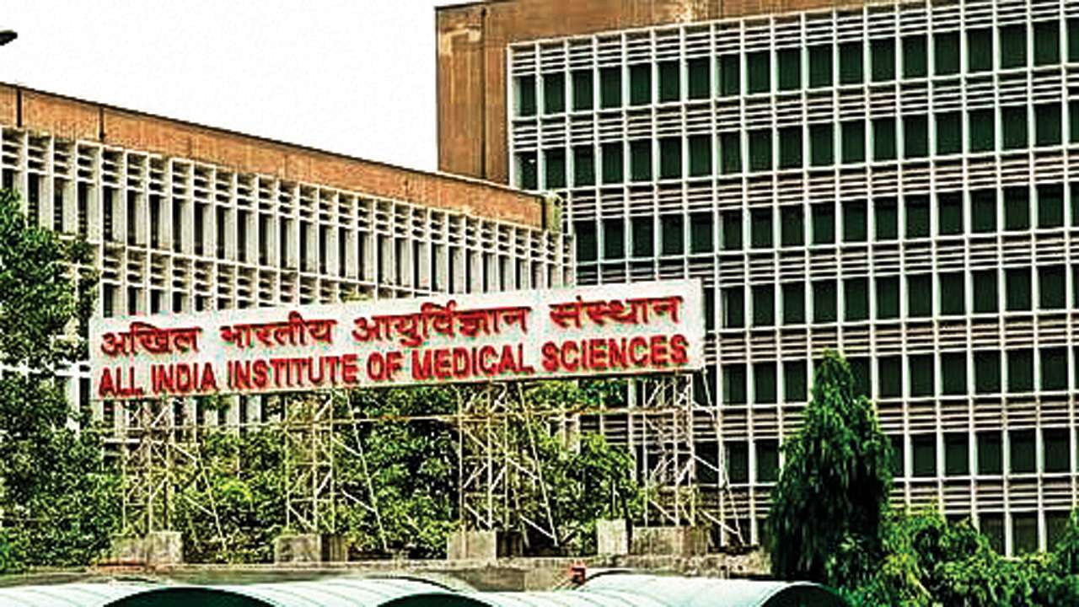
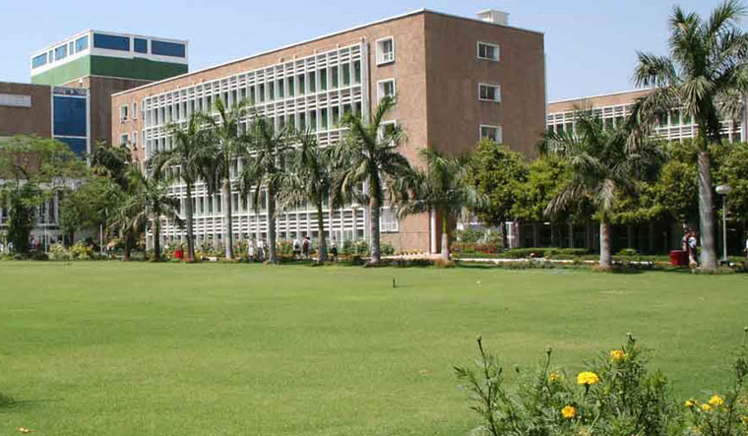
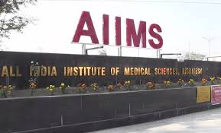
All India Institute of Medical Sciences (AIIMS)
AIIMS are a group of autonomous government public medical colleges of higher education (1956).
15 operating, 8 expected to become operational (2025).
8 AIIMS under development in phases.
AIIMS Madurai (P5).
AIIMS Darbhanga (P5).
AIIMS Assam (P5).
AIIMS Bilaspur (P5).
AIIMS Jammu (P5).
AIIMS Kashmir (P5).
AIIMS Gujrat (P6).
AIIMS Haryana (P8).
AIIMS New Delhi (1956).
AIIMS Bhopal (2012).
AIIMS Bhubaneswar (2012).
AIIMS Jodhpur (2012).
AIIMS Patna (2012).
AIIMS Raipur (2012).
AIIMS Rishikesh (2012).
AIIMS Raebareli (2019).
AIIMS Mangalagiri (2018).
AIIMS Nagpur (2018).
AIIMS Gorakhpur (2019).
AIIMS Bathinda (2019).
AIIMS Bibinagar (2019).
AIIMS Kalyani (2019).
AIIMS Deoghar (2019).
Medical Associations:
Indian Medical Association (1928)
Indian Orthopaedic Association (1955).
Indian Academy of Pediatrics (1963)
Academy of Family Physicians of India (2010)

Slide 12
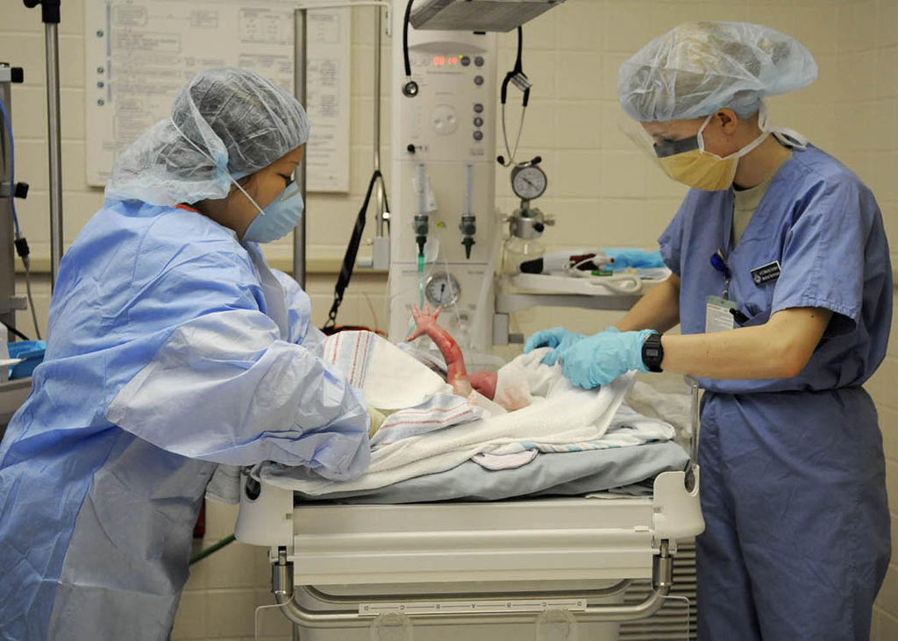
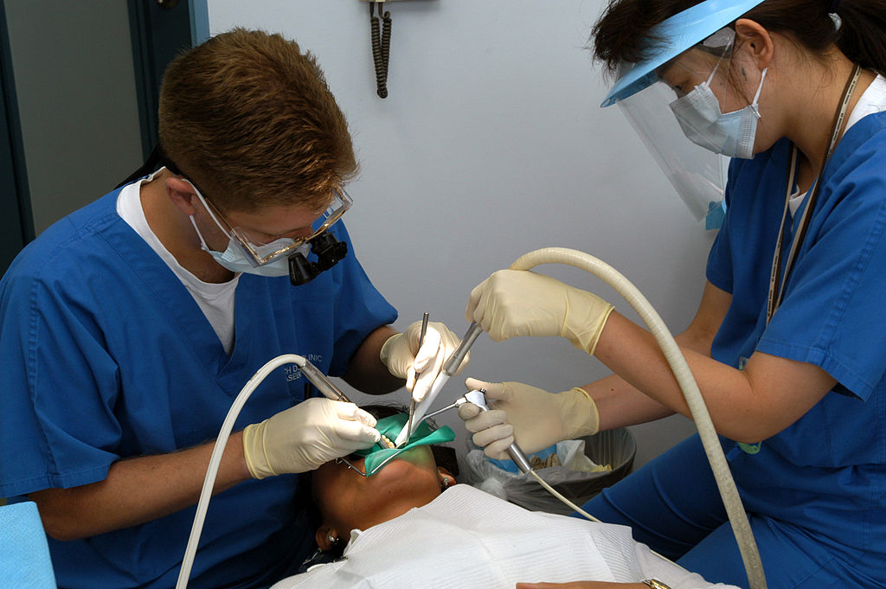
Health Professionals
Mental Health: Psychiatrists (assistant, nurse), Clinical psychologist, Occupational/marriage-family therapist, Clinical social worker, Counselor.
Maternal & Newborn Health: Obstetrician (nurse), Midwife, Physician (assistant).
Geriatric Care: Geriatrician (nurse, care manager, aide), Occupational therapist, Physician (assistant), Adult-Gerontology nurse, Clinical nurse, Pharmacist, Caregiver.
Surgery: Surgeon (assistant, nurse, technologist), Physician (assistant), Anesthesiologist (assistant, nurse, technician), Clinical officer, Operative (nurse).
Rehabilitation Care: Physiatrist, Physician (assistant), Rehabilitation (counsellor, nurse), Clinical nurse, Physiotherapist (technician), Chiropractor, Orthotist (technician), Prosthetist (technician), Respiratory/Occupational/Recreational/Physical therapist, Audiologist, Speech & Language pathologist, Athletic trainer, Personal Care assistant.
Eye Care: Opthalmologist, Optometrist, Physican assist.
Medical Diagnosis: Radiographer, Radiologist, Sonographer, Medical Laboratory scientist, Pathologist.
Oral Care: Dentist (surgeon, assistant, hygienist, nurse, technician, therapist), Dental auxillaries, Oral therapist.
Foot Care: Podiatrist (assistant, nurse), Chiropodist, Pedorthist.
Public Health: Medicine specialist, Physican (assistant), Public Health (nurse, dentist), Pharmacist, Clinical nurse specialist, Dietitian, Environmental Health officer, Paramedic, Epidemiologist.
Alternative Medicine: Accupuncture, Ayurveda, Herbalism, Homeopathy, Naturopathy, Reiki, Siddha medicine, Traditional Chinese medicine, Traditional Korean medicine, Unani, Yoga.

Slide 13
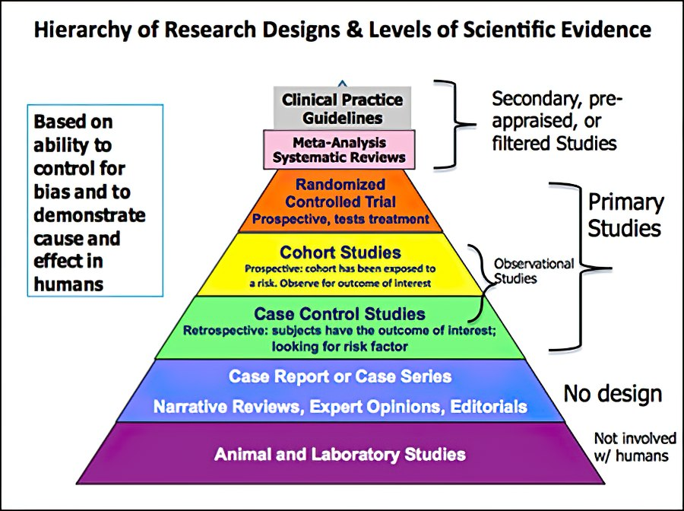
Evidence based medicine
Conscientious, explicit and judicious use of current best evidence in making decisions about the care of individual patients.
Case report/series: Few participants w/ similar intervention, and follow up.
Case control studies: Retrospectively looks at participants (past), control group wo/ intervention (early studies, identify variables that predict a condition).
Cohort studies: Follows large group over extended period of time to see how exposures affect outcomes. Used to look at suspected risk factors that cant be controlled experimentally (longitudinal / epidemiological studies).
Randomized Controlled Trials (RCT): Individuals randomly assigned into 2+ groups, with 1 control group that recieves no intervention, a placebo (true experimental design).
Meta-analysis: Statistical summary across multiple studies for finding effect of an intervention.
Systematic reviews: Birds eye view of results of studies side-by-side (highest quality evidence). Cochrane Database of Systematic Reviews, Joanna Briggs Institute EBP Database, Database of Abstracts of Reviews of Effects (DARE).
In vitro (test tube) studies

